Slide 1

Stack & Airthmetic Expression
The way to write arithmetic expression is known as a notation.
An arithmetic expression can be written in three different but equivalent notations, i.e., without changing the essence or output of an expression. These notations are −
Infix Notation
Prefix (Polish) Notation
Postfix (Reverse-Polish) Notation

Slide 2

Arithmetic Expression Conversion (An application of stack)
One of the applications of Stack is in the conversion of arithmetic expressions in high-level programming languages into machine readable form.
As our computer system can only understand and work on a binary language, it assumes that an arithmetic operation can take place in two operands only e.g., A+B, C*D,D/A etc.
But in our usual form an arithmetic expression may consist of more than one operator and two operands e.g. (A+B)*C(D/(J+D)).
These complex arithmetic operations can be converted into polish notation using stacks which then can be executed in two operands and an operator form.

Slide 3
Infix Expression
It follows the scheme of
<operand><operator><operand>
i.e. an <operator> is preceded and succeeded by an <operand>.
Such an expression is termed infix expression. E.g., A+B
operators are used in-between operands.
It is easy for us humans to read, write, and speak in infix notation but the same does not go well with computing devices.
An algorithm to process infix notation could be difficult and costly in terms of time and space consumption.

Slide 4
Prefix Notation
In this notation, operator is prefixed to operands, i.e. operator is written ahead of operands.
For example, +ab.
This is equivalent to its infix notation
a + b.
Prefix notation is also known as Polish Notation.

Slide 5
Postfix Expression
It follows the scheme of
<operand><operand><operator>
i.e. an <operator> is succeeded by both the <operand>.
E.g., AB+
This notation style is known as
Reversed Polish Notation.
In this notation style, the operator is postfixed
i.e., the operator is written after the operands.
For example,
ab+.
This is equivalent to its infix notation a + b.

Slide 6
Examples
Sr.No. | Infix Notation | Prefix Notation | Postfix Notation
1 | a + b | + a b | a b +
2 | (a + b) ∗ c | ∗ + a b c | a b + c ∗
3 | a ∗ (b + c) | ∗ a + b c | a b c + ∗
4 | a / b + c / d | + / a b / c d | a b / c d / +
5 | (a + b) ∗ (c + d) | ∗ + a b + c d | a b + c d + ∗
6 | ((a + b) ∗ c) - d | - ∗ + a b c d | a b + c ∗ d -

Slide 7
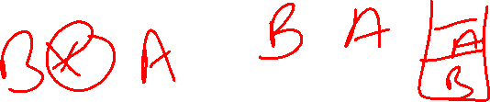
Parsing Expressions
It is not a very efficient way to design an algorithm or program to parse infix notations.
Instead, these infix notations are first converted into either postfix or prefix notations and then computed.
To parse any arithmetic expression, we need to take care of operator precedence and associativity also.

Slide 8

Precedence
When an operand is in between two different operators, which operator will take the operand first, is decided by the precedence of an operator over others. For example −
As multiplication operation has precedence over addition, b * c will be evaluated first. A table of operator precedence is provided later.

Slide 9
Associativity
Associativity describes the rule where operators with the same precedence appear in an expression.
For example, in expression a + b − c,
both + and – have the same precedence,
then which part of the expression will be evaluated first,
is determined by associativity of those operators.
Here, both + and − are left associative,
so the expression will be evaluated as
(a + b) − c.

Slide 10
Associativity
Precedence and associativity determines the order of evaluation of an expression.
Following is an operator precedence and associativity table (highest to lowest) −
Sr.No. | Operator | Precedence | Associativity
1 | Exponentiation ^ | Highest | Right Associative
2 | Multiplication ( ∗ ) & Division ( / ) | Second Highest | Left Associative
3 | Addition ( + ) & Subtraction ( − ) | Lowest | Left Associative

Slide 11
The above table shows the default behavior of operators. At any point of time in expression evaluation, the order can be altered by using parenthesis. For example −
In a + b*c, the expression part b*c will be evaluated first, with multiplication as precedence over addition. We here use parenthesis for a + b to be evaluated first, like (a + b)*c.

Slide 12
Evaluation rule of a Postfix Expression states:
While reading the expression from left to right, push the element in the stack if it is an operand.
Pop the two operands from the stack, if the element is an operator and then evaluate it.
Push back the result of the evaluation. Repeat it till the end of the expression.

Slide 13


Algorithm
1) Add ) to postfix expression. 2) Read postfix expression Left to Right until ) encountered 3) If operand is encountered, push it onto Stack [End If] 4) If operator is encountered, Pop two elements i) A -> Top element ii) B-> Next to Top element iii) Evaluate B operator A push B operator A onto Stack 5) Set result = pop 6) END

Slide 14
As discussed in Infix To Postfix Conversion Using Stack, the compiler finds it convenient to evaluate an expression in its postfix form. The virtues of postfix form include elimination of parentheses which signify priority of evaluation and the elimination of the need to observe rules of hierarchy, precedence and associativity during evaluation of the expression.
As Postfix expression is without parenthesis and can be evaluated as two operands and an operator at a time, this becomes easier for the compiler and the computer to handle.

Slide 15
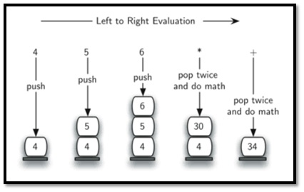
Expression: 456*+

Slide 16
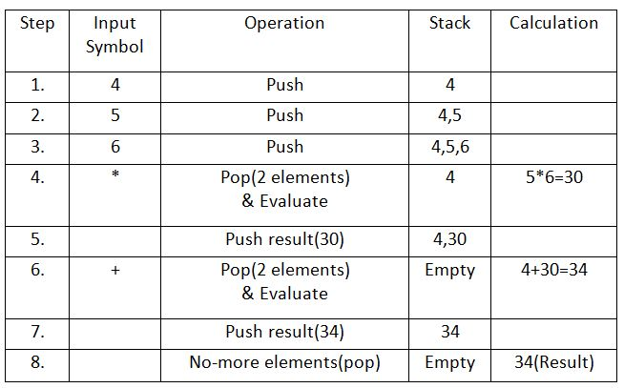
Evaluation of a Postfix Expression

Slide 17
Algorithm to convert Infix To Postfix
Let, X is an arithmetic expression written in infix notation. This algorithm finds the equivalent postfix expression Y.
Push “(“onto Stack, and add “)” to the end of X.
Scan X from left to right and repeat Step 3 to 6 for each element of X until the Stack is empty.
If an operand is encountered, add it to Y.
If a left parenthesis is encountered, push it onto Stack.
If an operator is encountered ,then:
Repeatedly pop from Stack and add to Y each operator (on the top of Stack) which has the same precedence as or higher precedence than operator.
Add operator to Stack. [End of If]
If a right parenthesis is encountered ,then:
Repeatedly pop from Stack and add to Y each operator (on the top of Stack) until a left parenthesis is encountered.
Remove the left Parenthesis. [End of If] [End of If]
END.

Slide 18
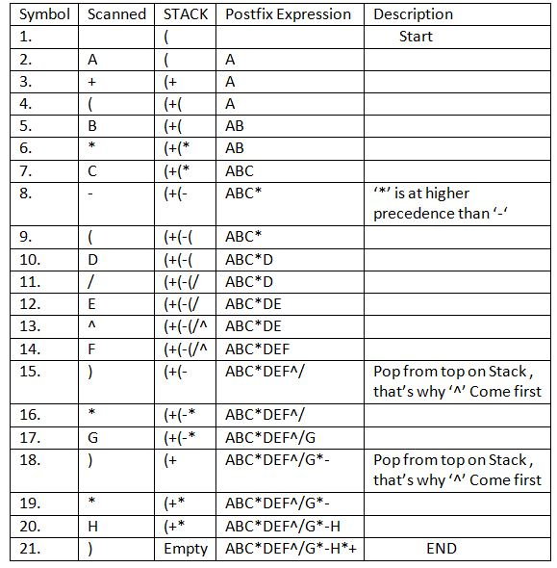
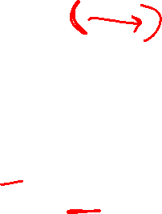
Infix Expression: A+ (B*C-(D/E^F)*G)*H, where ^ is an exponential operator.

Slide 19
Resultant Postfix Expression: ABC*DEF^/G*-H*+

Slide 20
Advantage of Postfix Expression over Infix Expression
An infix expression is difficult for the machine to know and keep track of precedence of operators. On the other hand, a postfix expression itself determines the precedence of operators (as the placement of operators in a postfix expression depends upon its precedence).Therefore, for the machine it is easier to carry out a postfix expression than an infix expression.

